Slide 1


Slide 2

a system requirements document containing hundreds,
or even thousands, of requirements, written in a natural language
such documents may be filled with problems
easy for the client to understand, and the model must be structured
such that it can be cross referenced with the original document

Slide 3




Behavior Tree notation
inconsistencies
redundancies
incompleteness
ambiguities
syntax
number

Slide 4
a formal semantics for the Behavior Tree notation
Communication Sequential Processes (CSP)
(Hoare:1976,1977,1985)
extend this language to include state-based constructs
a message passing facility similar to publish/subscribe models of communication
CSPσ

Slide 5
a formal semantics for the Behavior Tree notation
CSPσ
Message passing
Behavior Trees
Translating Behavior Trees to CSPσ

Slide 6
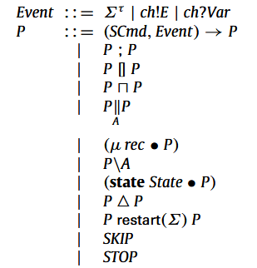

The basic unit for synchronisation are events, given by the set Σ. Elements of the set Σ are either an event name or the pairing of a channel name with an associated value in the set Val.
我
specification commands (SCmd)
It’s the basic state-manipulation construct in this language. A specification command x1, . . . , xn: [R] contains a two-state predicate R and a frame x1, . . . , xn, which is the (possibly empty) set of variables which the command may alter. An example is i: [i′ = i + 1].
When the frame of a specification command is empty (and hence its predicate does not refer to any post-state (primed) variables), we call it a guard, and write it as [g]. We also allow an update, x := E, where x ∈ Var and E is a single-state expression, to abbreviate the specification command x: [x′ = E].

Slide 7
Expressions and predicates
Single-state expressions Expr₁
An expression, E, may be instantiated with a state, σ , to form a new expression, E[σ], such as
Two-state expressions are given by the type Expr₂
An instantiation of E ∈ Expr2 , requires two states, i.e., E[σ, σ′], such as
An expression either one or two state, we just use the type Expr
A predicate E is satisfiable, written sat(E), when there exist pre- and post-states σ and σ′, defined for all free variables in E, such that E[σ, σ′] evaluates to true.
Notes:
predicate是一种布尔值函数，所谓布尔值函数，即自变量x映射到因变量y，y的取值是true或者false。

Slide 8
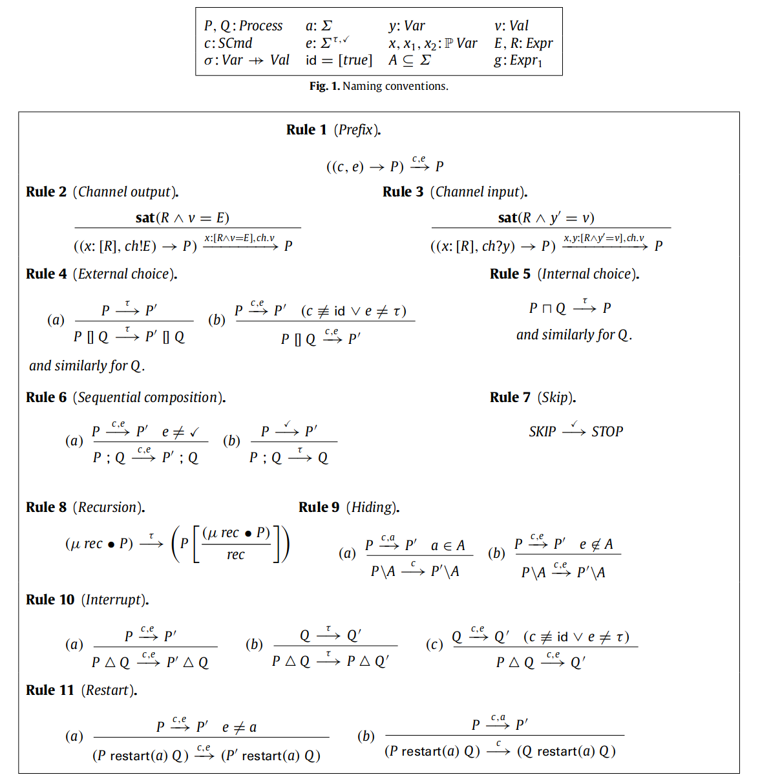





Slide 9
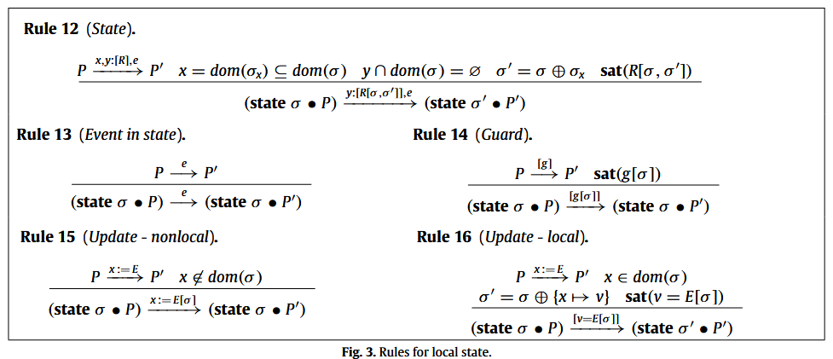
A new mapping of values in x, σx, is nondeterministically chosen so that R[σ , σ ′] is satisfiable, where σ ′ = σ ⊕ σx is the updated local state containing the new values for x.
The operator ‘⊕’ is function override, that is, given functions f and g, the function f ⊕ g maps inputs according to g for elements in the domain of g, and all others according to f , that is, (f ⊕ g)(x) = g(x) if x ∈ dom(g), and f (x) otherwise.

Slide 10


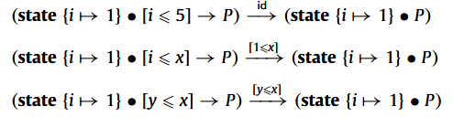
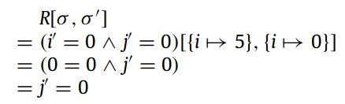
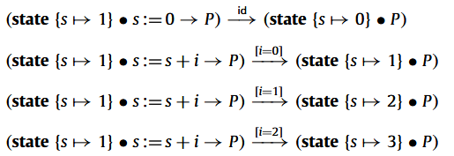

Update nolocal
Update local
Notes:
在这x相当于i，y相当于j，σ_{x}相当于i->0，σ ′ = σx
The substitution serves to eliminate the parts of R that refer to the local state, while the sat(..) constraint restricts the poststate σ ′ to only valid choices of new values. Since sat(j′ = 0) holds, we may derive the following transition.
替换用于消除R中引用本地状态的部分，而sat（..）约束限制后状态σ'只对新值进行有效的选择。由于sat(J'=0)成立，我们可以导出以下转变。

Slide 11
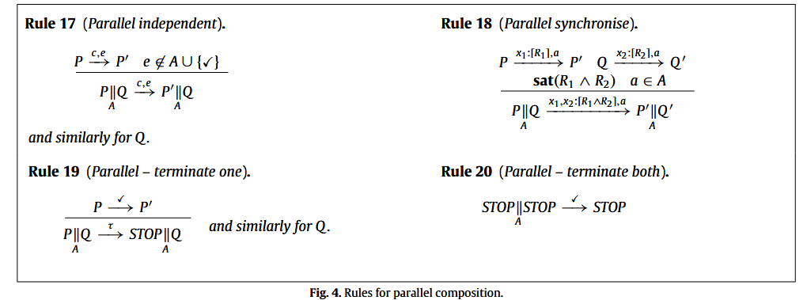

Slide 12
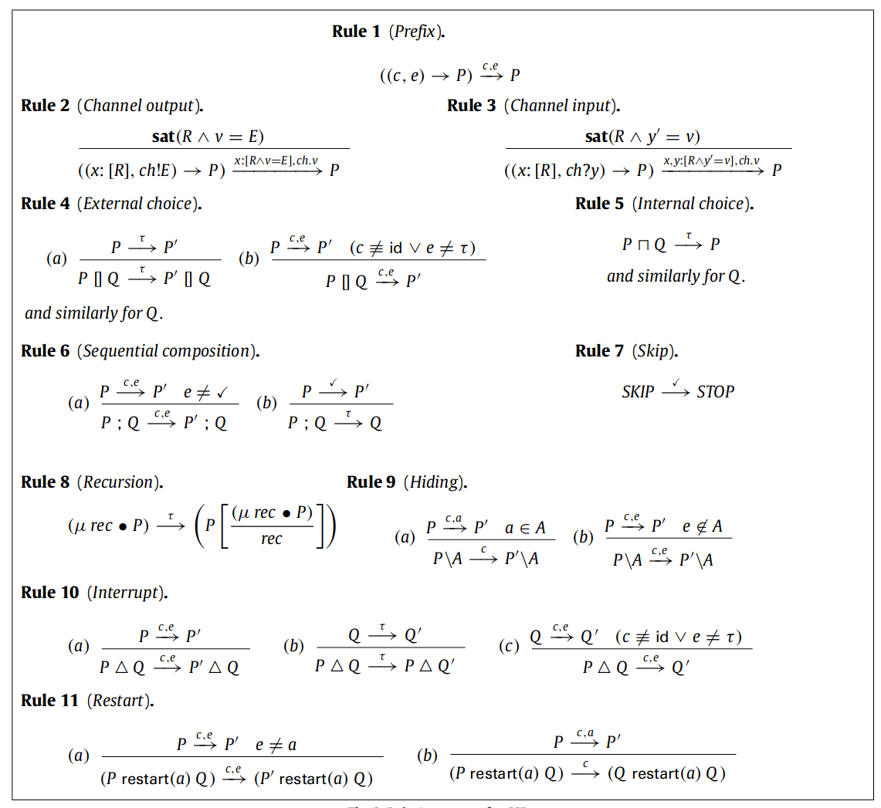
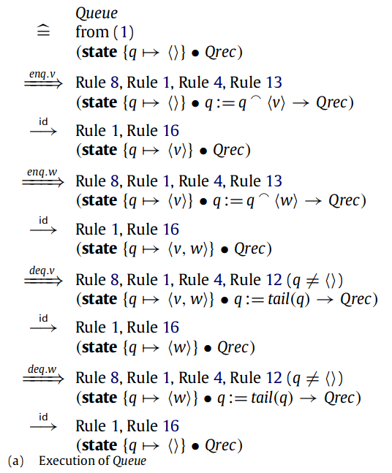

Slide 13
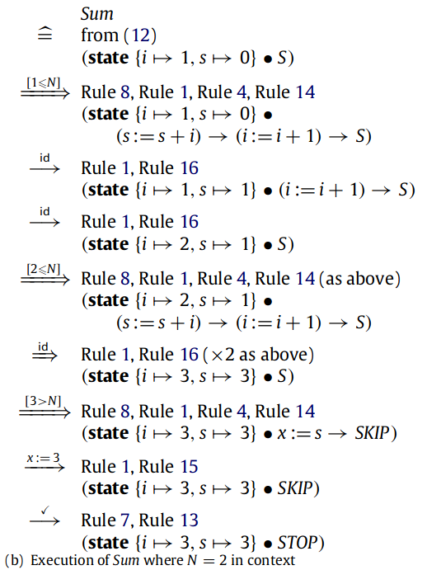

Slide 14
a formal semantics for the Behavior Tree notation
CSPσ
Message passing
Behavior Trees
Translating Behavior Trees to CSPσ

Slide 15
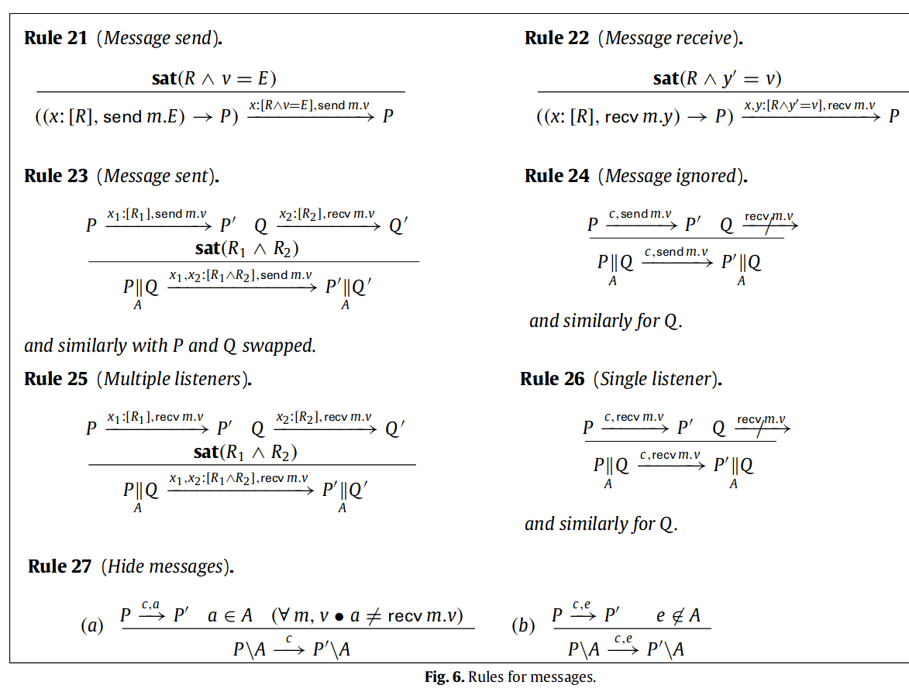
send m.E
recv m.y
does not need to block until there is a receiver
publish/subscribe model
multiple sending processes
Notes:
多对多

Slide 16
a formal semantics for the Behavior Tree notation
CSPσ
Message passing
Behavior Trees
Translating Behavior Trees to CSPσ

Slide 17
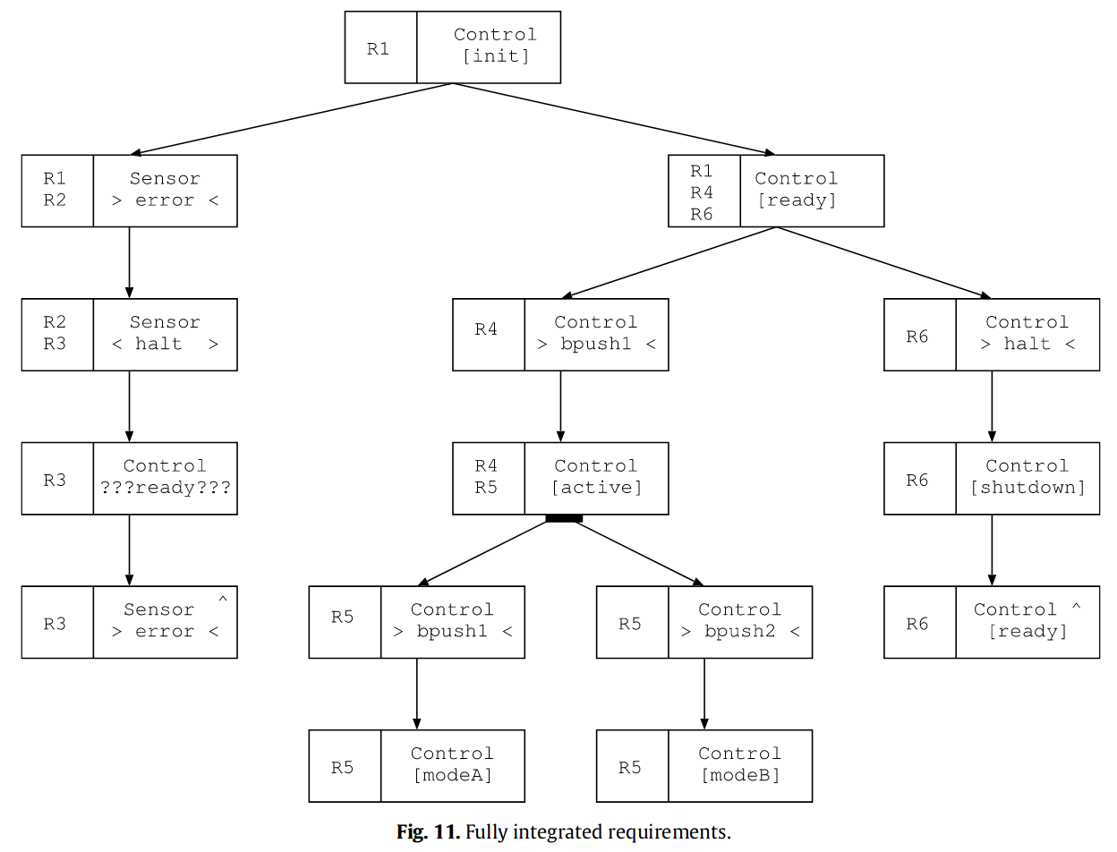

Slide 18
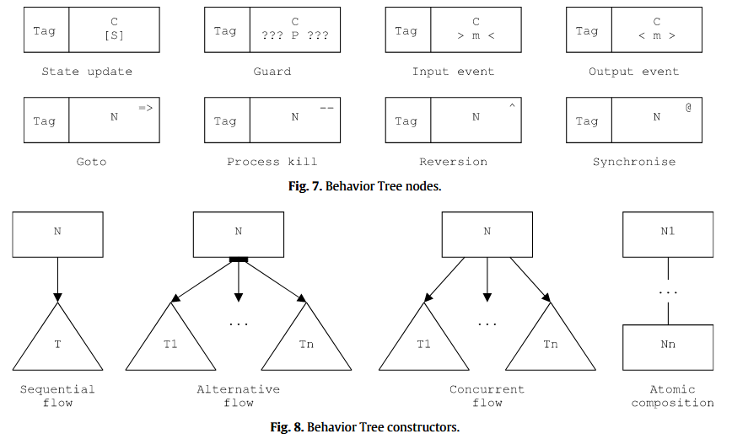
Node types
leaf
leaf
Node modifiers
Each node refers to a specific component (C ), and describes some operation involving that component.
update node：updates the state of C to some expression S
guard node：blocks until predicate P is satisfied by C ’s state
message-based communication：An output event node indicates that C generates message m (possibly with a list of values). The input event node blocks until C receives message m (storing the passed values (if any) into a list of variables).
goto node：used as a shorthand if the same behaviour occurs in different parts of the tree, source and target nodes of a goto must appear in sibling branches in an alternative flow
kill node：terminates any behaviour associated with the tree rooted at node N
reversion node：allows iteration, any behaviour associated with the tree rooted at node N
synchronisation node：each process synchronising on N blocks until all other such processes are also at the synchronisation node

Slide 19
Sequential flow：node N is executed, after which T is ready for execution. Because several trees may be executing in parallel, it is possible that the behaviour of other nodes will be interleaved before and after N
Alternative flow：one of T1, . . . , Tn will be executed after N
Concurrent flow：after N is executed, all of the trees are ready for execution
Atomic composition： the nodes operate together in a single atomic action, with the order of execution being sequentially from N1 to Nn. must contain at most one node with a non-internal event, at most one node of type input/output event, process kill, reversion, and synchronisation.

Slide 20
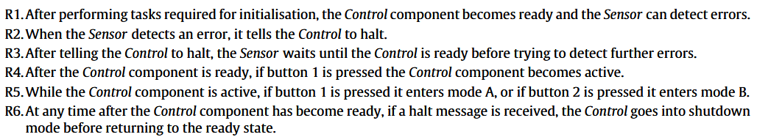
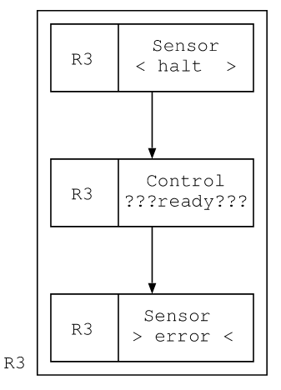
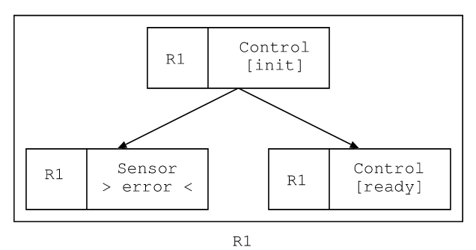
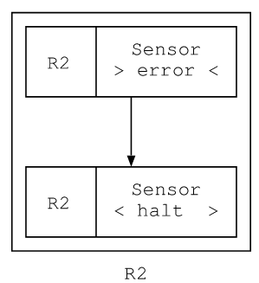

Slide 21
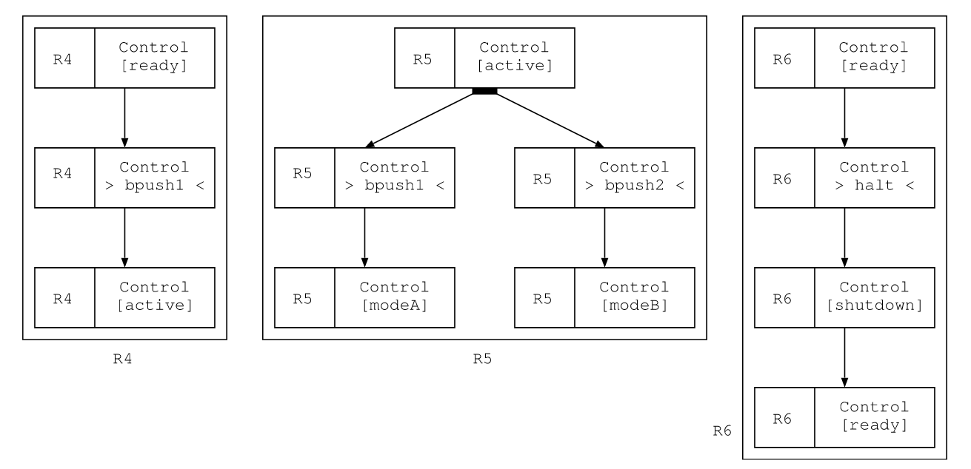

Slide 22
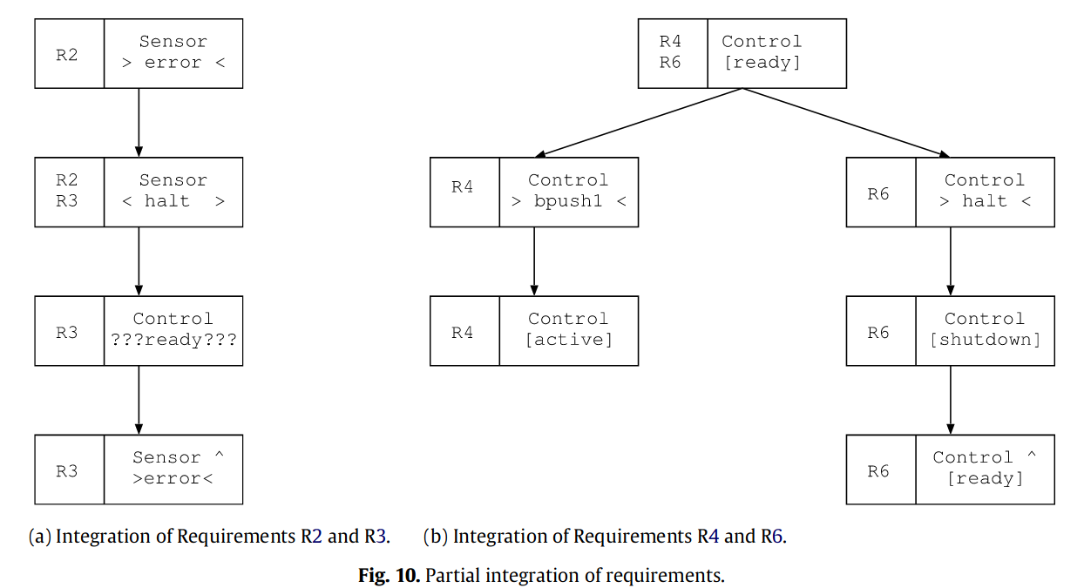

Slide 25
a formal semantics for the Behavior Tree notation
CSPσ
Message passing
Behavior Trees
Translating Behavior Trees to CSPσ

Slide 26
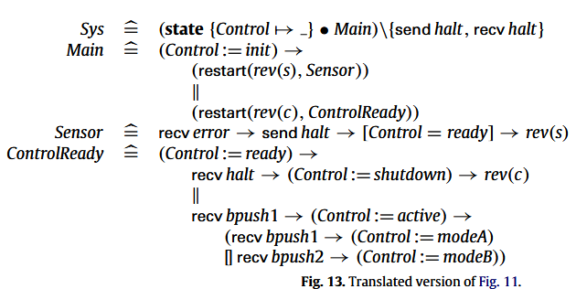
Notes:
Sys定义整个系统上下文
control的初始值未知，隐藏了系统内的halt message，error和bpush没隐藏，因为这是系统外的
parallel, alternative, and sequential flow, and the node types state update, guard, input/output event and reversion.

Slide 27
Three phases
①replace goto nodes N=> with the target tree, which we write as tree(N), i.e., the subtree with root node N
②identifies and marks subtrees that are the target of process kill and reversion
transform the marked trees into CSPσ processes recursively
collects state and event information(hide)

Slide 28
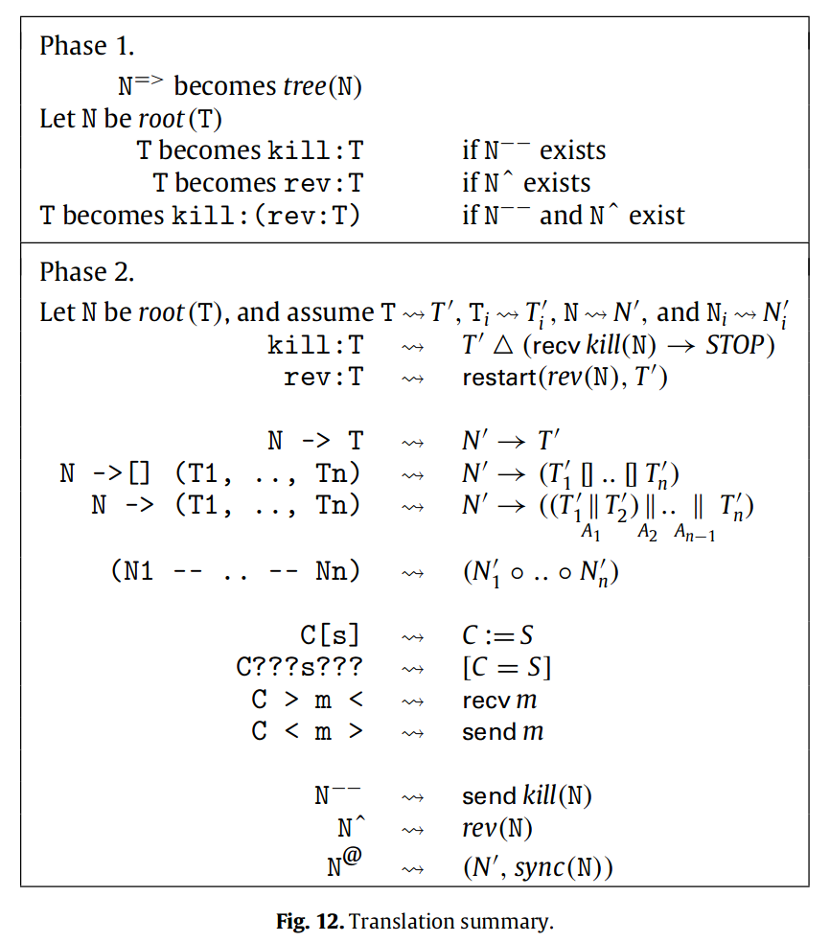


The difference between reversion and recursion: in a reversion the behaviour of relevant sibling threads must terminate. In this sense, a reversion behaves as a restart. When a thread with a reversion does not contain any parallelism, then the behaviour is identical to that of recursion.
Every time the controller restarts the system through unfolding r, a new copy of the sensor thread will be generated.

Slide 29
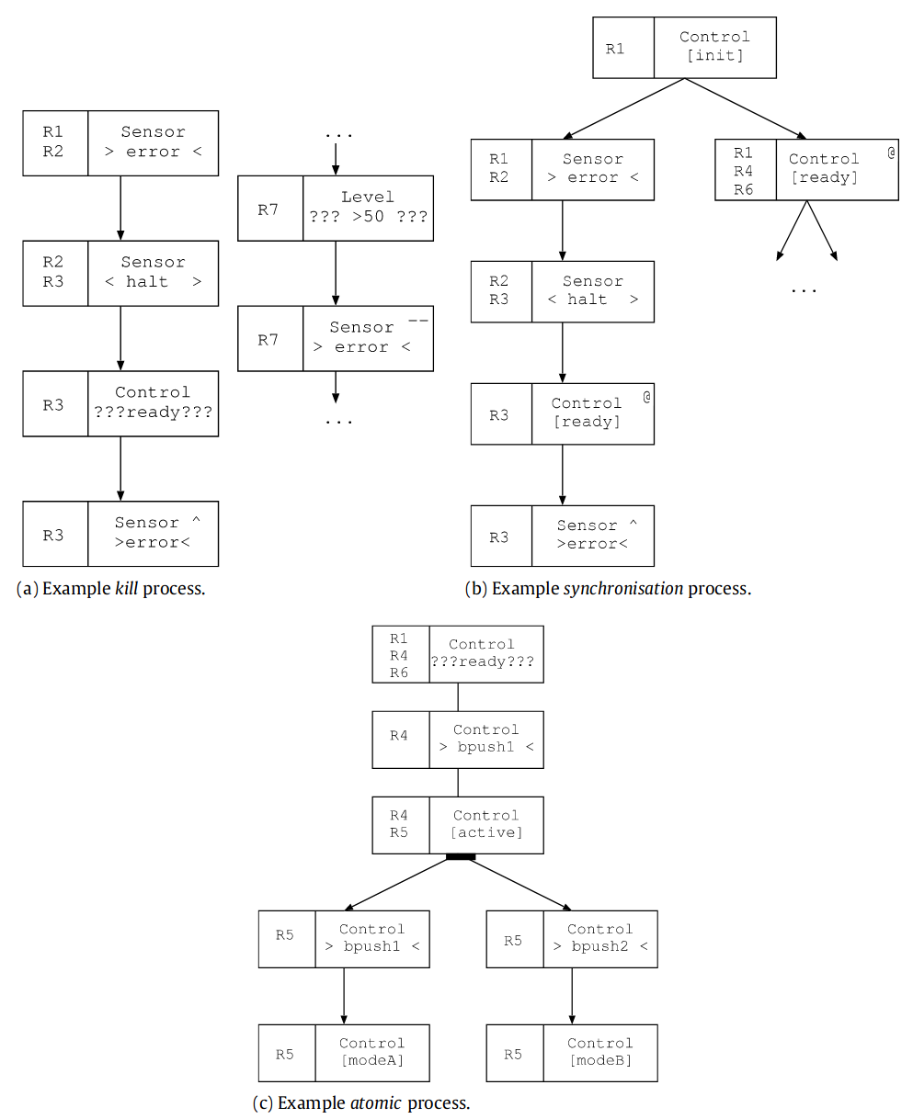
+R7：The Sensor terminates if the level exceeds 50
combined into
a single
atomic action
using a guard, the Sensor will not become ready until the next time the Sensor process takes a step

Slide 30
Thank you

Slide 31
State-based constructs
A specification command x: [R], interpreted as a relation, SR, on total states, that satisfies R and modifies only variables in x.
That is, given total states S, S′ ∈ (Var → Val), the relation corresponding to x: [R], given by [[x: [R]]], contains (S, S′) if S and S′ make R true and only variables in x may differ.
A special specification command is id, which we define as [true]
Notes:
域：仅限于不在 x 中的元素

Slide 32
?
To prevent traces where a receiver responds to an ‘external’ message, the scope over which the message is listened for must be limited (hidden) in the usual way. For instance, the smallest common ancestor of both sender and receiver will typically hide the receive message.
To allow receive actions to become internal events through hiding would be to allow them to transition without a corresponding send action. Hence, instead of becoming an internal step, a hidden receive message is prevented from transitioning at all
Notes:
信道&消息传递机制
1，多对多？
2，瞬时性？
3，不只能发送和接受值，工作通知
4，交互

